Slide 1
Pathogenic bacteria.
Dr.Munira Ch. Ismail Lec.3,4

Slide 2
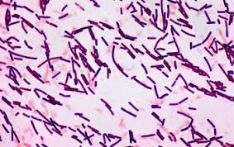
GRAM POSITIVE SPORE FORMING RODS.
Genus Bacillus.
Genus Clostridium.
1.GENUS: BACILLUS.

Slide 3
Bacillus anthracis.
• Major agent of bioterrorism and biological warfare.
• Major pathogen of domesic herbivores that come in contact with humans.
Pathogenesis and Clinical feature:
Acquired by the entry of spores through injured skin incutaneous anthrax, or mucus membrane in intestinal anthrax, or inhalation of spores in the lung while handling skin and hides.
How do animals get infected with anthrax?
Domestic and wild animals such as cattle, sheep, goats, antelope, and deer can become infected when they breathe in or ingest spores in contaminated soil, plants, or water. In areas where domestic animals have had anthrax in the past, routine vaccination can help prevent outbreaks.

Slide 4
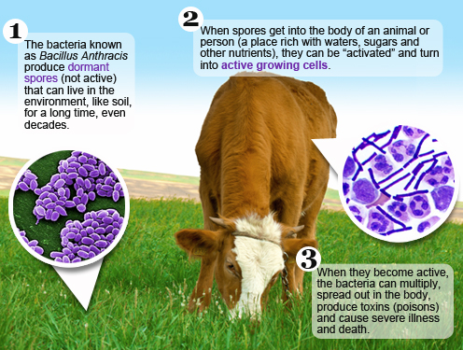

Slide 5
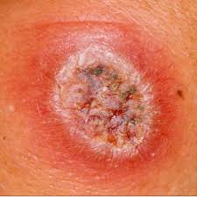
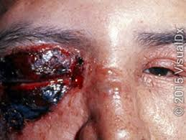
How do people get infected with anthrax?
People get infected with anthrax when spores get into the body. When anthrax spores get inside the body, they can be “activated.” When they become active, the bacteria can multiply, spread out in the body, produce toxins (poisons), and cause severe illness.
This can happen when people breathe in spores, eat food or drink water that is contaminated with spores, or get spores in a cut or scrape in the skin. It is very uncommon for people in the United States to get infected with anthrax.
Anthrax lestions.

Slide 6
There are four forms of anthrax.
1. Cutaneous anthrax (Malignant pustule): 95 % of anthrax Presentation.
Characterized by a black necrotic lesion with a definite edematous margin onhands, arms, face or neck with regional lymphadenitis associated systemic symptoms.
2. Pulmonary anthrax (Wool sorter’s disease):5% of anthrax presentation. .
Presents with substernal pain, cough with haemorrhagic mediastinitis and CXR-revealing mediastinal widening; and fatal if not treated early.
3. Bacteremic anthrax: presents with clinical features of sepsis.
4. Intestinal anthrax: Presents with abdominal pain,vomiting, and bloody diarrhea,Bacteremic and intestinal anthrax are rare to occur.

Slide 7
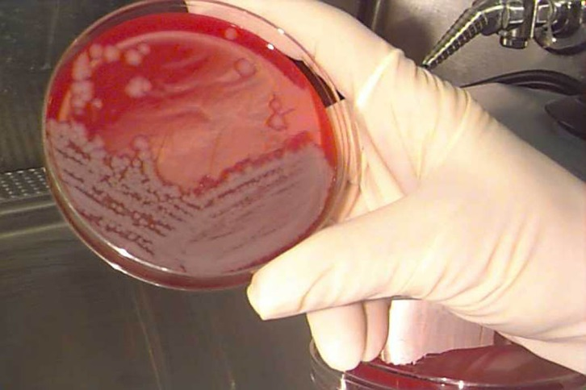
Laboratory diagnosis:
Specimen: Fluid or pus from skin lesion, Blood, sputum.
Smear: Non-capsulated gram-positive rods with centrally located spores from culture.Large capsulated gram-positive rods with out spores from primary specimen.
Culture: Grows aerobically in ordinary media over wide range of temperature.
Non-hemolytic,large, dense, grey-white irregular colonies with colony margin of “Medussa Head” or“curled-hair lock” appearance due to composition of parallel chaining of cells.0

Slide 8
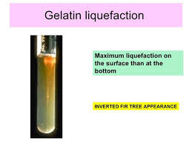
Biochemical reaction:
Gelatin-stab culture: Gelatin liquefaction Growth along the track of the wire with lateral spikes longest near the surface Providing “inverted fur tree” appearance.
Serology: ELISA has been developed to measure antibodies to edema toxin and lethal toxin.
Positive result: 4-fold change or single titer > 1:32
Serology: ELISA has been developed to measure antibodies to edema toxin and lethal toxin.
Positive result: 4-fold change or single titer > 1:32

Slide 9
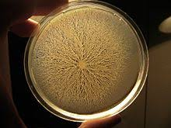
Bacillus cereus.
General characteristics:
Exhibit motility by swarming in semisolid media Produce β lactamase, so not sensitive to penicillin.
Swarming motility.

Slide 10
Clinical features:
1. Food poisoning.
Pathogenicity determinant: Exotoxin
a.Emetic type food poisoning.
IP is 1-5 hrs after ingestion of preformed toxin contaminating rice and pasta dishes.
Characterized by nausea, vomiting, abdominal cramps, and self-limited with in 24 hrs.
b. Diarrheal type food poisoning.
IP is 1-24 hrs after ingestion of contaminated meat dishes sporulating or preformed toxin.
Characterized by profuse diarrhea and abdominal cramps.Fever and vomiting is uncommon.

Slide 11
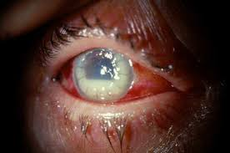
Lab. Diagnosis.
>105 org/gm of food
Isolation of B.cereus in stool is not diagnostic since it is present in normal stool specimen.
Treatment: Fluid replacement
Antibiotics not required
2. Ocular infection.
Ocular disease following trauma from non-sugical penetrating
Objects,manifests with keratitis, endophthalmitis, and panophthalmitis
Keratitis.

Slide 12
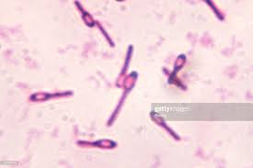
2. Genus: Clostridium.
Characteristics:
• Clostridia are anaerobic, spore-forming motile, gram-positive
rods.
• Most species are soil saprophytes but a few are pathogens to human.
• They inhabit human and animal intestine, soil, water,decaying animal and plant matter.
• Spores of clostridia are wider than the diameter of organism and located centrally, subterminally and terminally.

Slide 13
• Species of medical importance:
C. perfringens.
C. tetani.
C. botulinum.
. C.difficile
Clostridium perfringens.
Characteristics:
• Capsulated, non-motile, short gram-positive rods in which spores are hardly seen.
• there are five toxigenic groups : A-E
• Human disease is caused by C. perfringens type A and C.

Slide 14
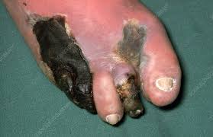
Clinical manifestation:
1. Clostridial myonecrosis: Gas gangrene.
. IP(Incubation period) =1-3 days
Colonization of devitalized tramatized wound by C.perfringens spores, and organism germiation and release of toxins.

Slide 15
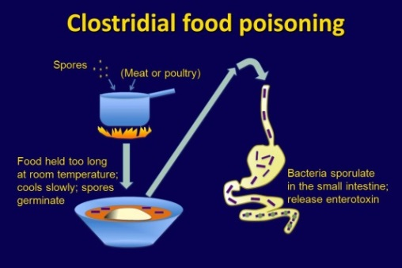
2. Clostridial food poisoning:
It causes secretory diarrhea due to release of enterotoxin in the
Intestine.
Self-limiting diarrhea similar to that produced by B.cereus.

Slide 16
Laboratory diagnosis:
Specimen: Infected tissue, pus, vomitus, left over food,serum.
Smear: Non-motile, capsulated, thick brick-shaped grampositive
rods in smears from tissue; spores are rarely seen.
Culture:
1. Blood agar medium.
. β-hemolytic colonies are seen in blood agar inanaerobic atmosphere.
. Some strains produce double zone of hemolysis.
2. Cooked meat medium(Chopped meat-glucose medium)
Thioglycolate medium.
. Saccharolytic property showing reddening of the meat with a rancid smell due to carbohydrate decomposition.
. Proteolytic property showing blackening of the meat with unpleasant smell due to protein decomposition.
. Formation of gas.

Slide 17
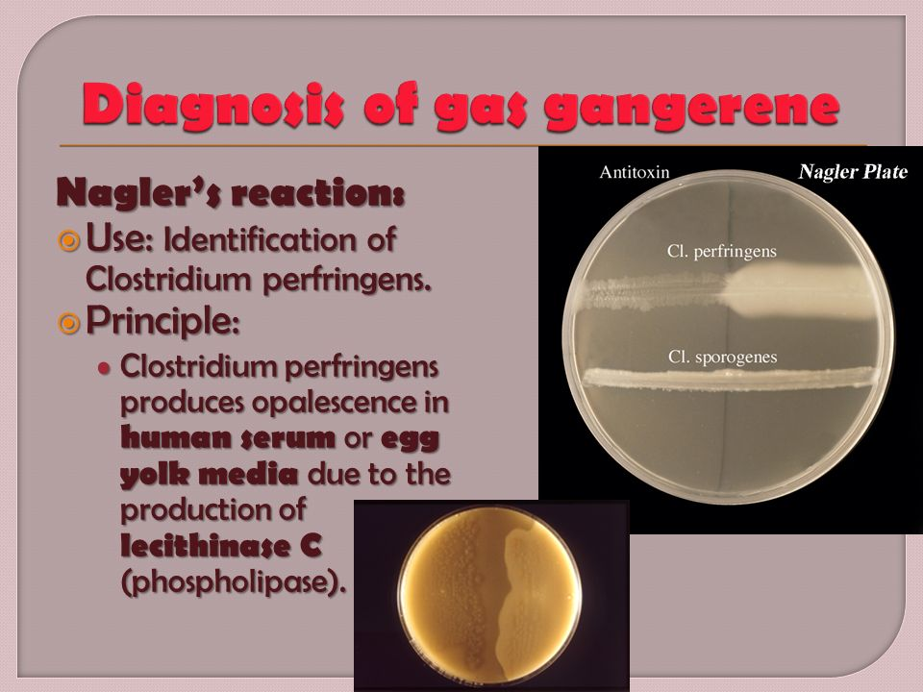
Biochemical reaction:
. Nagler reaction: Lecithinase C activity- Opacity in the egg-yolk
medium due to lecithin break down.

Slide 18
Closridium difficile.
General characteristics:
. Not frequently found in the healthy adult, but is found often in the hospital environment.
. Produce cytotoxins ( A and B).
. Human feces are the expected source of the organism
Pathogenesis and clinical features:
Administration of antibiotics like ampicillin, clindamycin and cephalosporins results in killing of colonic normal flora and proliferation of drug resistant C.difficile and release of cytoxins.
Clinically presents with pseudomembraneous colitis and manifests with fever, abdominal cramps, watery or bloody diarrhea leading to dehydration, septicemia and shock.
Lab. Dignosis:
Identification of toxin A and B in feces by latex agglutination test.

Slide 19
Clostridium tetani.
General characteristics:
• World wide in distribution in the soil and in animal feces.
• Longer and thinner gram-positive rods with round terminal spores giving characteristic “drum-stick” appearance.
• There are ten antigenic types of c. tetani but all produce the same neurotoxin.
• The toxin has two components:
1. Tetanospasmin: Neurotoxic property.
2. Tetanolysin: Hemolytic property.
Pathogenesis and Clinical manifestation:Infection of devitalized tissue (wound, burn, injury, umblical stamp, surgical suture) by spores of C.tetani → Germination of the spore and development of vegetative organism→
Neurotoxin release from vegetative cells → The toxin binds to receptors on the presynaptic membrane of motor neuron ,the retrograde axonal transport to the spinalcord and brain.
stem → Inhibition of inhibitory glycinergic and GABAergic secreting neurons → Spatic paralysis, muscle spasms and
hyperreflexia.
IP= 4-5 days to several wks.

Slide 20
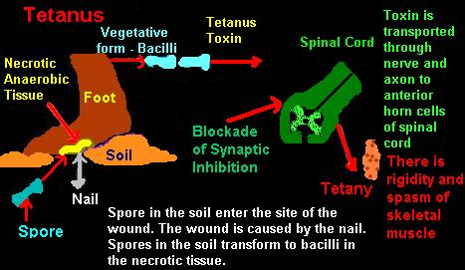
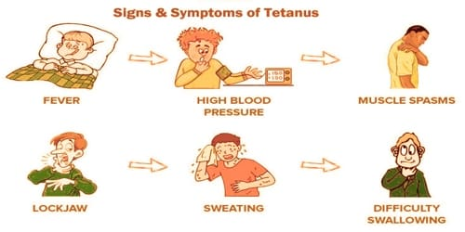

Slide 21
Laboratory diagnosis:
The bacteria can be cultured in a media with anaerobic atmosphere. Proof of isolation of C.tetani must rest on production of toxin and its neutralization by specific antitoxin .
.
Diagnosis is exclusively by clinical picture and history of injury.
Clostridium botulinum.
General characteristics:
• Spores of C. botulinum are widely distributed in soil, they often contaminate vegetables, fruits and other materials.
• Produce a neurotoxin which is the most active known poison, and considered to be the major agent of bioterrorism and biologic warfar.
There are seven serotypes(A-G) of which A,B and E are the principal causes of human illness.

Slide 22
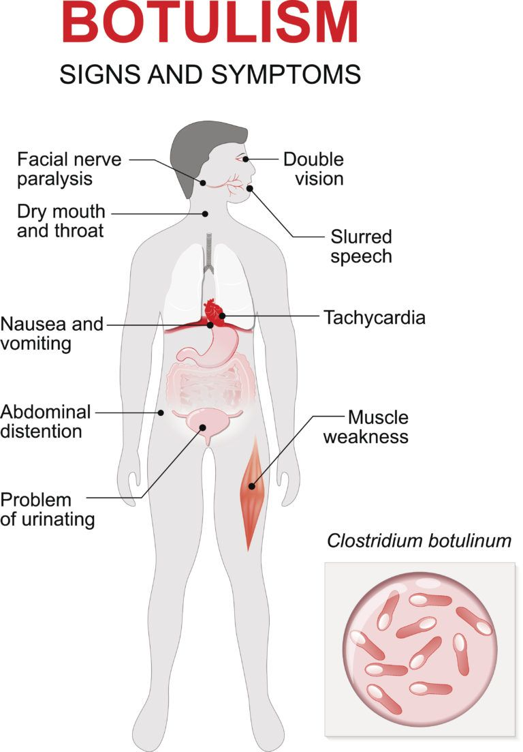
Pathogenesis and Clinical manifestation:

Slide 23
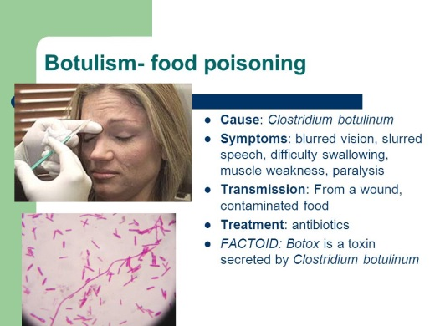
1. Food botulism.
. IP = 18-24 hrs.
. Route of entry is under cooked consumption of C.
botulinum toxin contaminated spiced, smoked, vaccumpacked or canned food.
.The toxin is absorbed from the gut and acts by blocking the release of acetylcholine at synapses and neuromuscular junction and manifests with
flaccid paralysis and visual disturbance, inability to swallow, and speech difficulty.

Slide 24
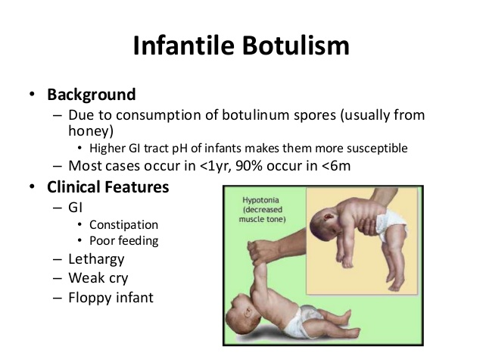
2. Infantile botulism.
C.botulinum type A or B is usually implicated and affects infants when mixed feeding starts (after fourth month of life).
Ingestion and colonisation of the gut with C.botulinum, and production of toxin and adsorption of toxin leads to poor feeding, paralysis (floppy baby), and cranial nerve palsy.
Diagnosed by demonstration of the organism or toxin from the stool.

Slide 25
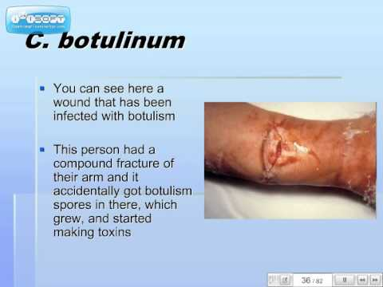
3. Wound botulism.
C.botulinum type A is usually implicated and caused by the production of toxin by C.botulinum in wounds.The symptoms are the same as those in food poisonig.
Laboratory diagnosis:
.Demonstration of toxin in patient’s serum and left over food.
. Death of mice after intra-peritoneal injection of toxin.

Slide 26


